Slide 1




JavaScript Best Practices
Learn How to Write Better Quality JavaScript
SoftUni Team
Technical Trainers
Software University
http://softuni.bg

Slide 2

Table of Contents
Naming Conventions in JavaScript
Using Variables Correctly
Hoisting of Declarations
Scoping
Global / Function / Fake Block Scope
Duplicated Object Identifiers
The "this" Object
In Global / Function / Object Scope / Event Handlers
Strict Mode
Think More Functionally in JavaScript
Exceptions

Slide 3

Naming Conventions in JavaScript

Slide 4
Naming Conventions
In JavaScript almost everything is camelCase
Variables, functions, properties, arrays, objects, modules
Use a leading underscore _ when naming hidden properties
var number = 5;
function printMsg(message){ … }
var arr = [];
arr.toString();
var controls = (function(){ … } ());
function Person(name) {
this._name = name;
}

Slide 5
Naming: Function Constructors
The only exception to the rule is function constructor
Use PascalCase for function constructors!
They are meant to be called with new
Without new, this has an incorrect value
JavaScript has no way to restrict a call to a function constructor without new
All we have to do is prey the developer sees the visual difference
function Person(name) {
this._name = name;
}
var pesho = new Person();
When you see PascalCase function, call it with new!

Slide 6

Variables in JS
Best Practices

Slide 7


Declaring Variables
Always use var to declare variables
Without var the variable will become global variable
Avoid polluting the global namespace
minka = new Student();
var minka = new Student();

Slide 8
Declaring Variables (2)
Declare all the variables in the beginning of the scope
Even if they will not be used yet
This prevents lots of error-prone code
Use one var declaration for multiple variables
Declare each variable on a new line
function something(){
var number;
var word;
var eventNumbers;
…
}
function something(){
var number,
word,
eventNumbers;
…
}

Slide 9
Variables - Objects, Arrays, Strings
Use the literal syntax for objects and arrays
Use single quotes '' for strings
var obj = new Object();
var obj = {};
var arr = new Array();
var arr = [];
var name = "Petya";
var name = 'Petya';
var name = "Petya " + lastName;
var name = 'Petya ' + lastName;

Slide 10
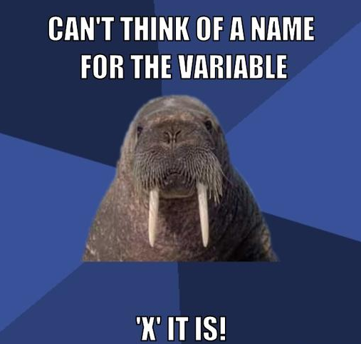
Variables
Live Demo

Slide 11
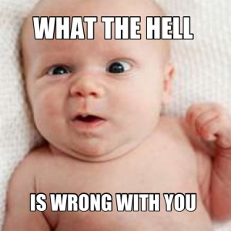
JavaScript Hoisting
Moving the Declarations at the Function Start

Slide 12
JavaScript Hoisting
Variable declarations get hoisted to the top of their scope
Their assignment does not hoisted
Function declarations hoist their name and the function body
translated to
var a;
console.log(a);
a = 5;
console.log(a);
var a = 5;
function calculate() {
calculateArea();
function calculateArea() {
console.log('Calculated');
}
}
function calculate() {
function calculateArea() {
console.log('Calculated');
}
calculateArea();
}
translated to

Slide 13
JavaScript Hoisting (2)
Function expressions hoist only their name
Never use function declaration in non-function block (if, while…)
Error: undefined is not a function
var calc;
calc();
calc = function calc() {
// implementation
}
calc();
var calc = function calc() {
// implementation
}
translated to
if ( … ) {
function calc() { … }
}
if ( … ) {
var calc = function calc() { … }
}

Slide 14

Scoping
Using Global, Function and Object Scope

Slide 15
Scoping in JS
JavaScript has only two types of scope
Global scope and function scope
Function scope may be called object scope when used with new
There is no block scope in JavaScript
{ and } do not define a scope
Use IIFE to define scope
All JavaScript code, in all files, share the same global scope

Slide 16
No Block Scope in JS
Everything inside an if-else, for or while "block scope" is actually outside this block
Both printMsg and count are declared
count has no value, because the execution flow cannot reach the initialization
if (false) {
var count = 15;
function printMsg(message) {
console.log("Message: " + message + "!");
};
}
printMsg(count) // Message: undefined!
Both count and printMsg are defined

Slide 17

Fake "Block" Scope
Live Demo

Slide 18
Function Scope
Function scope is the only scope where variables are temporary
A variable, declared with var, does not exist outside of its function scope
(function(){
if (false) {
var count = 15;
function printMsg(message) {
console.log("Message: " + message + "!");
};
}
}());
printMsg(count); // ReferenceError: printMsg is not defined

Slide 19
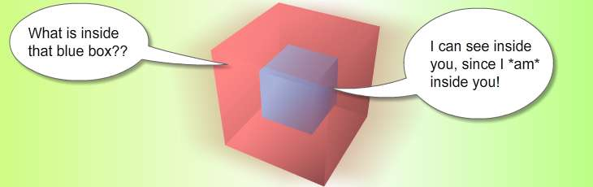
Function Scope
Live Demo

Slide 20

Conditional Expressions & Equality

Slide 21
Conditional Expressions & Equality
Use === and !== over == and !=
Use shortcuts in conditional statements
if (name !== '') { … }
if (name) { … }
if (name == '') { … }
if (!name) { … }
if (number.length > 0) { … }
if (number.length) { … }

Slide 22
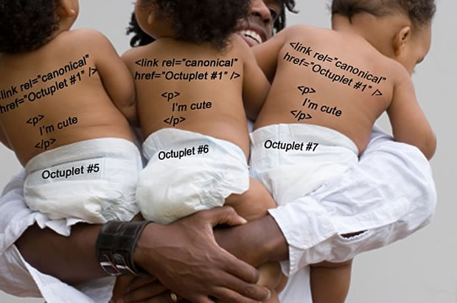
Duplicated Object Identifiers

Slide 23
Duplicated Object Identifiers
Be careful with duplicate object identifiers in the shared JS global scope
If two libraries / frameworks / JS files have a function with the same name, which one will be used?
Prevent duplicated identifiers by using function scope or module
Expose only the meaningful pieces through namespaces / modules
jsConsole.write("Message");
document.write("Message");
database.write("Message");

Slide 24
Duplicated Object Identifiers
Live Demo

Slide 25

The this Object

Slide 26
The "this" Object
The this object has a different value depending on the scope:
Function scope
this is window / global object, when is called without new
this is created object, when is called with new
Object scope
this === current object
Global scope
this is window (in browser) / global (in Node.js)
Event handlers
this holds the event source

Slide 27
"this" in Global Scope
In the global scope this means the global scope
i.e. window in browser
i.e. global in Node.js
These work exactly the same when in global scope
console.log(this === window) // logs true
console.log(this === global) // logs true
this.message = 'Hello';
var message = 'Hello';
window.message = 'Hello';

Slide 28
"this" in Function Scope
this in function scope almost always means the this of the parent of the function
If the function is in the global scope this means the global scope
In object scope – this means the object itself
Later in this presentation
(function createAndSetVariable(number) {
this.number = number;
}(5));
console.log(number); // logs 5
this means window / global

Slide 29
"this" in Object Scope
Object scope is created when a function is called with new
The rules that apply are the same as with regular function call
Except for the value of this
Always beware of PascalCase-named functions
There is a reason for that!
function Person(fname, lname) {
this.fname = fname;
this.lname = lname;
}
var person = new Person();
var invalidPerson = Person();
this means an instance of the person object
this means the window

Slide 30
"this" in Event Handlers
this in an event handler means the event source (the DOM element that the event was fired on)
i.e. if a click event fires on some button, this means the clicked button
var button = document.getElementById('button');
button.addEventListener('click', function (ev) {
console.log(this === button); // logs true
}, false);

Slide 31

Strict Mode
Just 'use strict'

Slide 32
Strict Mode in JS
Strict mode is a nice subset of the JavaScript functionality
Removes some of the bad parts of JavaScript
Adds parts of yet-to-be ECMAScript versions
Strict mode changes both syntax and runtime behavior
Makes changes to the syntax to prevent silent errors
Restricts functionality to remove bad JavaScript
Makes the transition to new JavaScript features more seamless
'use strict'

Slide 33
Strict Mode Usage
Strict mode can be used
For the whole script
Per-function
If used for the whole scripts, everything is in strict mode
Not a good idea, since a third-party script may fail in strict mode
Better use IIFE and per-function strict mode
That way only your code will run in strict mode
'use strict';
function f1() { … }
function f2() { … }
function f3() { … }
function f1() {
'use strict';
…
}

Slide 34
Strict Mode Properties
Some of the characteristics of strict mode:
Converts silent errors to exceptions
Trying to change the value of document
Deleting the prototype of an object
Makes this undefined inside a function scope
In a function scope, this is equal to undefined, instead of the parent this object
Forbids octal syntax (e.g. x = 020 would be invalid)
Prevents variable declaration without var

Slide 35
Strict Mode
Live Demo

Slide 36

JavaScript Execution Order

Slide 37
How and When JavaScript Executes?
As we know, JavaScript executes in per-line-reached basis
The execution flow goes from top to bottom
Imagine all loaded JavaScript files, merged together in one really big JavaScript file is executed
A JavaScript line of code is executed, when it is reached in the execution process
Yet execution may take time
Time that is not pleasant to the user

Slide 38
JavaScript Execution – Best Practices
Start execution of JavaScript, when the Web page is ready
And there is an event for that
Or, if using jQuery, we can use its load event
Loading the script at the end of the load time, ensures that all the DOM is already rendered
window.onload = function() {
//do the code preparations
}
$(document).ready(function(){});
$(function(){});

Slide 39

JavaScript Loading in the HTML File

Slide 40
JavaScript Loading in the HTML File
A common question is "Where to load the JavaScript?"
Load the JS in the HTML <header> section?
Load the JS at the end of the <body> element?
Load the JS somewhere in the document?
All JavaScript files have the same global scope, so it really doesn't matter?
No, it does matter!
The order of loading HTML, CSS, and JS scripts is important

Slide 41
JavaScript Load in the HTML File (2)
There are two common places to load the JavaScript files
In the HTML <header>
At the end of the <body>
What is really the difference?
Performance!
Loading of large script file at the header, freezes the Web page
Better load your JavaScript at the end of the body
This will show rendered HTML and CSS before the scripts
At the end load your JavaScript code, and run it at document.ready

Slide 42
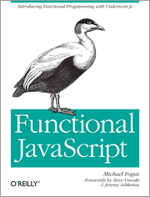
Think More Functionally in JavaScript

Slide 43
Think Functional in JavaScript
Use more functional versus imperative programming in JS
Log numbers with for-loop
Log numbers with forEach function
var numbers = [12, 32, 23];
for(var i = 0; i < numbers.length; i += 1) {
var number = nums[i];
console.log(number);
}
numbers.forEach(function(num) {
console.log(num)
});

Slide 44
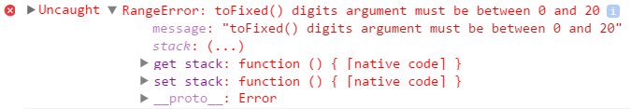
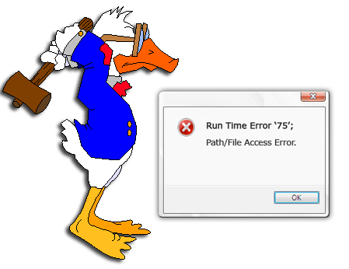
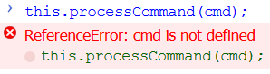
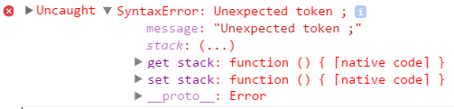
JavaScript Exceptions

Slide 45
JavaScript Exceptions
Exceptions are special objects that hold information about errors / unusual situations
The correct way to handle errors in most programming languages
In JS almost every object / function can throw an exception
JavaScript uses exceptions as primary way to handle errors
Supports the classical throw / try / catch statements
When a problem occurs in JS, an exception is thrown
Some functions return strange neutral value for non-fatal errors
E.g. new Date('hello') → returns 'Invalid date' object
Notes:
In the programming language C “throwing an exception” means to return a value that is defined as an error value for the function (e.g. -1).

Slide 46


Throwing Exceptions in JS

Slide 47
Throwing Exceptions in JS
The throw statement throws an exception
Execution of the current function will stop
Control will be passed to the first catch block, if there is any
The expression after throw specifies the object to throw
You can throw anything, but prefer Error / object with message
Each of the following throws an exception:
throw "Something is going wrong!";
throw 42;
throw new Error('Congratulations. You are pregnant!');

Slide 48
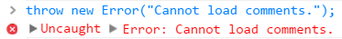

Throwing Exceptions
Live Demo

Slide 49
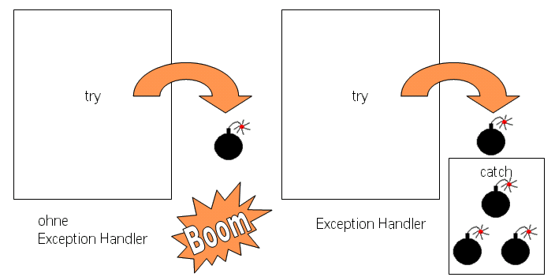
Exception Handling in JavaScript
Catching and Processing Exceptions

Slide 50
Exception Handling (2)
Exception handling is done using a try-catch block
If an error occurs inside the try block, the control is passed to the catch section
try {
// code that can throw an exception
} catch (ex) {
// this code is executed in case of exception
// and ex holds the info about the exception
}

Slide 51
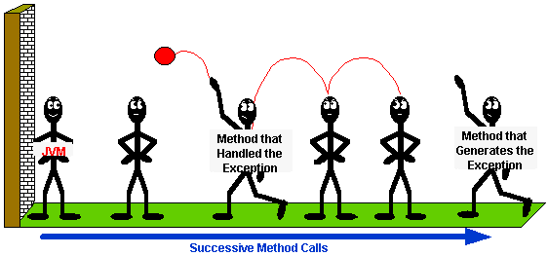
Exceptions and Their Properties
Live Demo

Slide 52
More about Custom Exceptions
Any JS object can be thrown as exception
A good practice is to have a "message" property
Throw Error or object holding "message" (which is faster)
Don't throw string or other objects
throw { message: "Cannot load comments." };
throw { message: "Age is out of range", minAge: 0, maxAge: 135 };
throw new RangeError("Age should be in range [1...100].");
throw "Error!" // Don't do this!

Slide 53

Throwing Objects
Live Demo

Slide 54


Summary
Beware of variables and hoisting
Beware of scoping (no block scope in JS)
Functional and global scope
Beware of "this"
"this" may have many meanings in global / function / object scope / event handlers
Use 'strict mode'
JS OOP

Slide 55







JavaScript Best Practices
https://softuni.bg/courses/javascript-oop/

Slide 56
License
This course (slides, examples, demos, videos, homework, etc.) is licensed under the "Creative Commons Attribution-NonCommercial-ShareAlike 4.0 International" license
Attribution: this work may contain portions from
“JavaScript Basics" course by Telerik Academy under CC-BY-NC-SA license

Slide 57





Free Trainings @ Software University
Software University Foundation – softuni.org
Software University – High-Quality Education, Profession and Job for Software Developers
softuni.bg
Software University @ Facebook
facebook.com/SoftwareUniversity
Software University @ YouTube
youtube.com/SoftwareUniversity
Software University Forums – forum.softuni.bg

